Slide 1
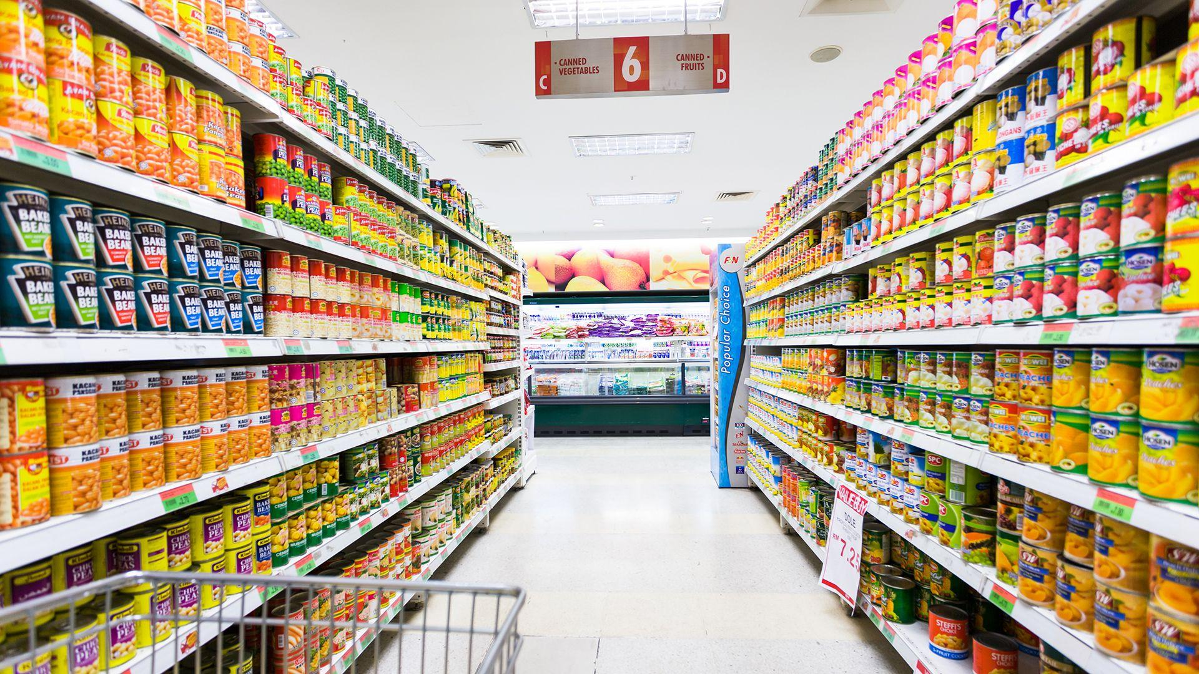
Super Market Billing System

Slide 2
USES Of SUPER MARKET BILLING SYSTEM
Automated Billing: The system generates accurate bills quickly, reducing manual errors.
Inventory Management: It helps track stock levels in real-time and alerts when items are low.
Sales Tracking: Records all transactions, making it easier to analyze sales data and trends.
Customer Management: Maintains records of regular customers and their purchase history.
Tax Calculation: Automatically calculates applicable taxes like GST, ensuring compliance.
Reports Generation: Creates daily, weekly, or monthly sales and inventory reports for management.

Slide 3
Link for GitHub Repository
https://github.com/Kush1401/Super-Market-Billing-System-using-Python

Slide 4
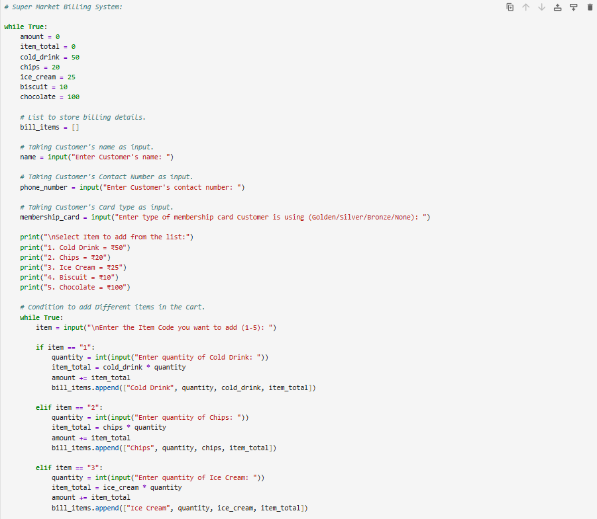
Sample Code for Billing System

Slide 5
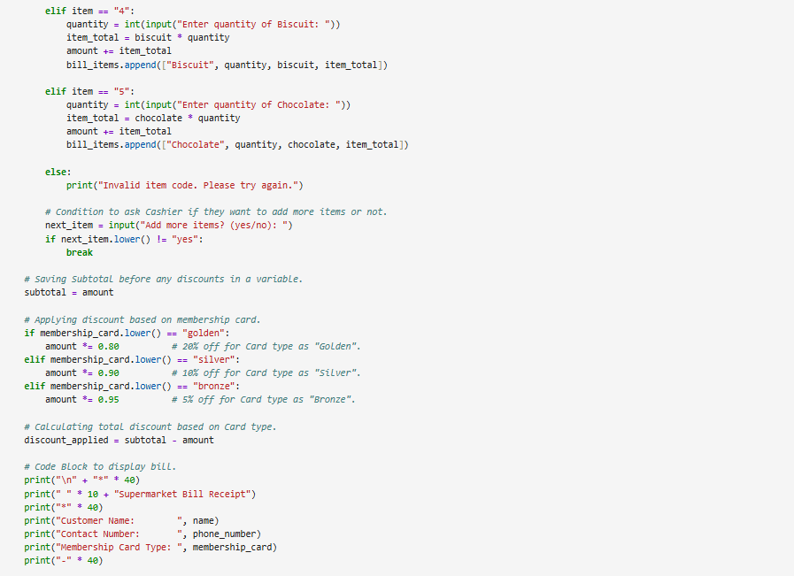
To Be Continued

Slide 6
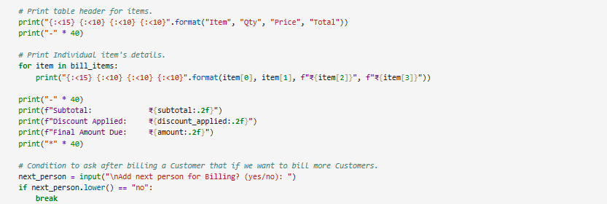
To Be Continued

Slide 7
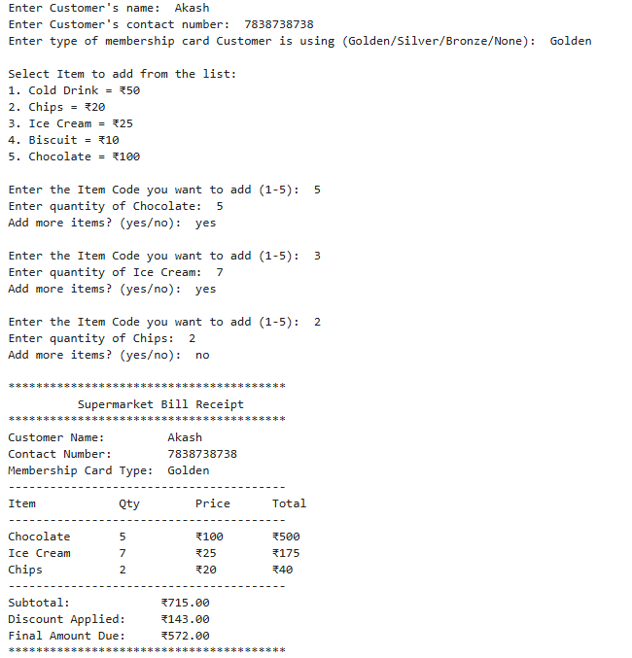
Sample Test Case 1

Slide 8
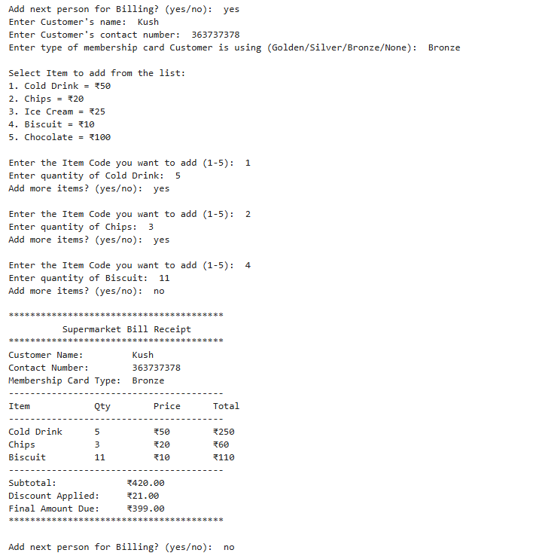
Sample Test Case 2

Slide 9

Thank You
Presented By: Kushagra

